Slide 1




NEXT GEN EMPLOYABILITY PROGRAM
Creating a future-ready workforce
Team Members
College Name
Student Name:
Ancelin Amali.A.V
Student ID : au960221104018
Arunachala College of Engineering for Women

Slide 2

CAPSTONE PROJECT SHOWCASE
Project Title
Car Rentals Application with Django Framework
Abstract | Problem Statement | Project Overview | Proposed Solution | Technology Used | Modelling & Results | Conclusion

Slide 3
Abstract
It is a user-friendly car rental app, streamlining the booking process for customers. It offers real-time availability, flexible booking, secure payments, and personalized recommendations. With convenient pick-up and drop-off options, optional add-ons, and robust safety measures, it aims to make car rentals hassle-free and accessible to all.
Source :

Slide 4
Problem Statement
"Current car rental systems lack user-friendly features, causing inconvenience and frustration for customers during the booking process. Create an web-application to overcome these problems"
Source :

Slide 5
Project Overview
The project aims to develop, a user-centric car rental app. It will offer real-time availability tracking, flexible booking, secure payments, and personalized recommendations. It prioritizes convenience with pick-up/drop-off options, optional add-ons, and robust safety measures, aiming to revolutionize the car rental industry.
Source :

Slide 6
Proposed Solution
.
It a comprehensive car rental application, will revolutionize the industry by offering a user-centric solution. It will feature a user-friendly interface with real-time availability tracking, flexible booking options, secure payment processing, and personalized recommendations based on user preferences.
Source :

Slide 7
It will prioritize convenience with various pick-up/drop-off locations, optional add-ons like GPS navigation and insurance coverage, and robust safety measures. By integrating these features, it aims to streamline the car rental process, making it accessible, convenient, and reliable for all users.
Source :

Slide 8


Technology Used
Front-end
Back-end
Source :

Slide 9
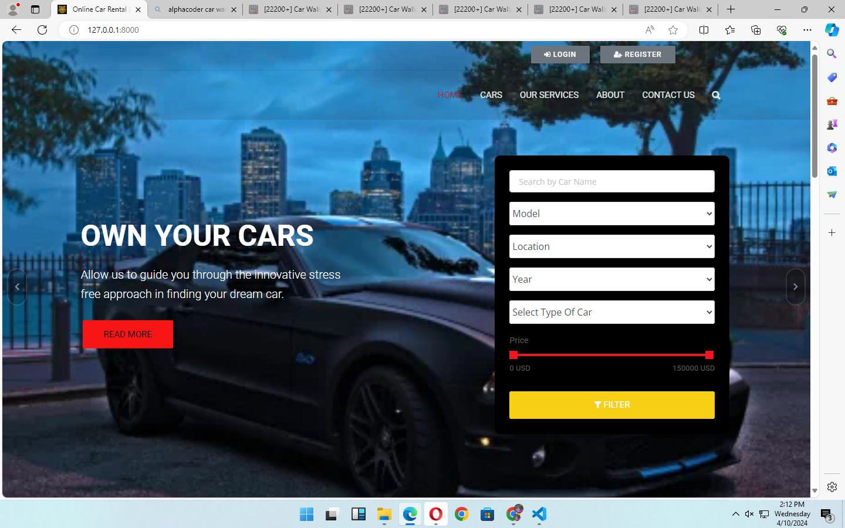
Modelling & Results
Source :

Slide 10
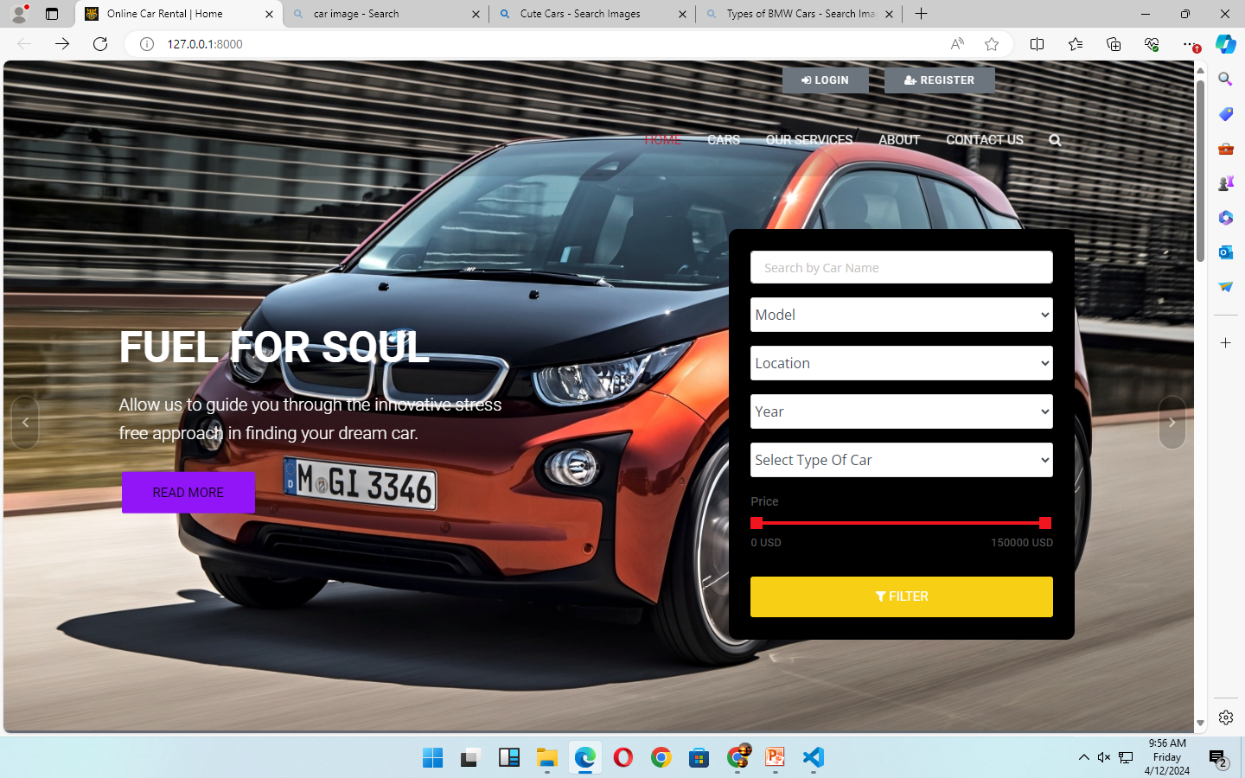
Homepage

Slide 11
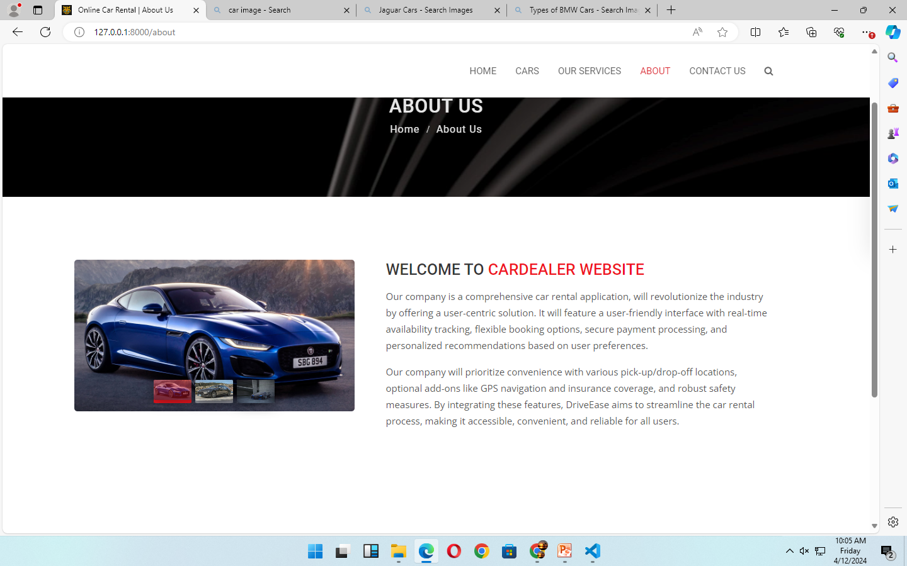
About-Us-Page

Slide 12
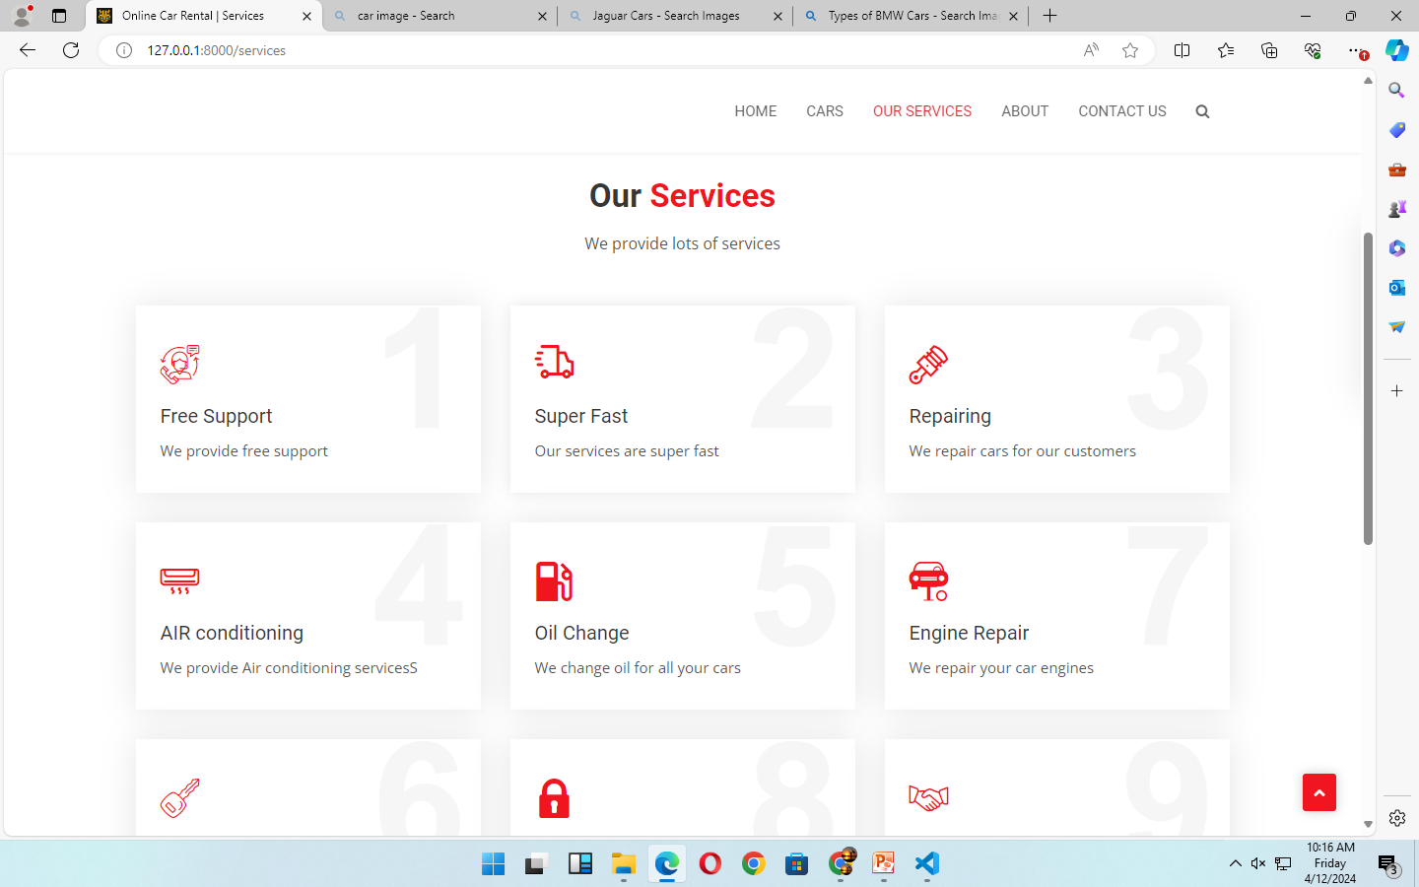
Service-Page

Slide 13
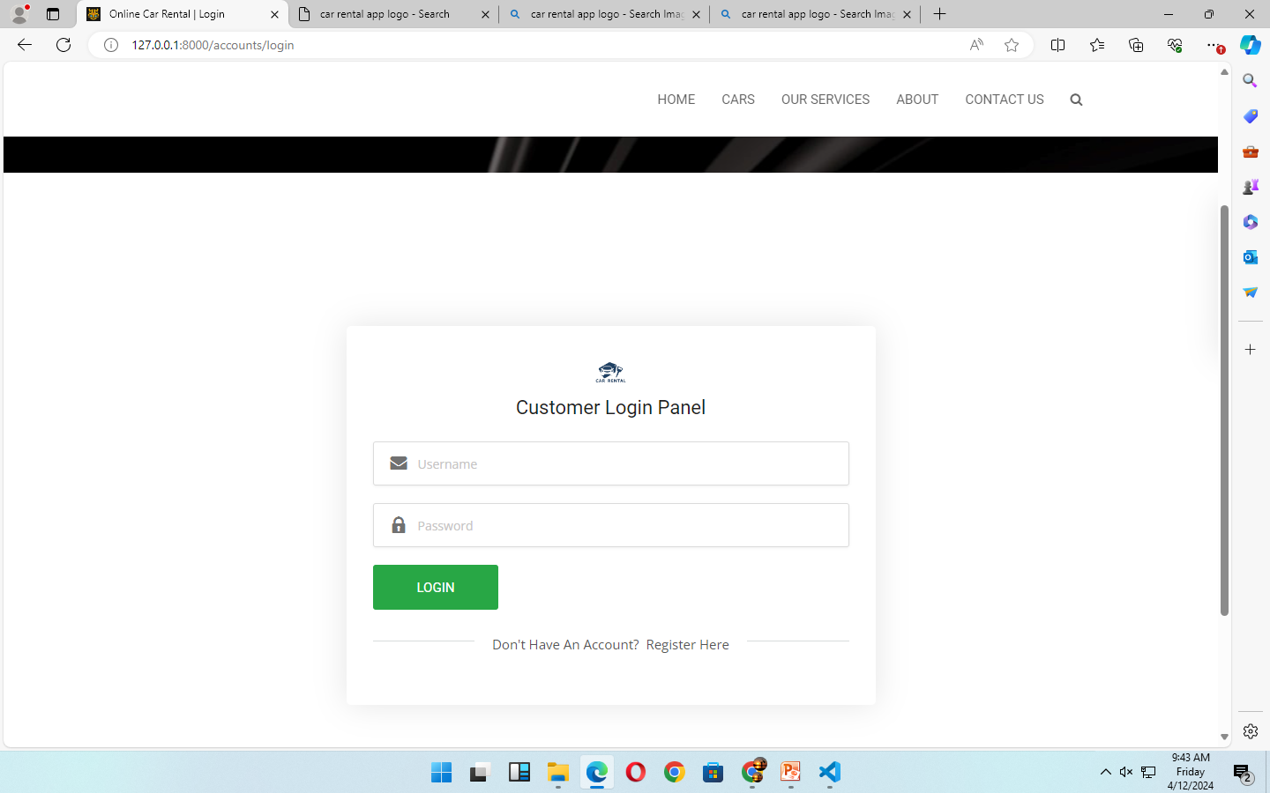
Login page

Slide 14
Future Enhancements:
The integration of advanced AI-powered features
Expanding the services to include alternative transportation options
The integration of blockchain technology
Enhance security, transparency, and efficiency within the platform

Slide 15
Conclusion
It offers a user-centric solution to streamline car rentals, prioritizing convenience, security, and personalization. With its intuitive interface, real-time availability tracking, and flexible booking options, it aims to revolutionize the industry and make mobility accessible and hassle-free for all users. Through continued innovation and enhancements, it is poised to remain a leader in the evolving landscape of transportation services.
Source :

Slide 16
Thank You!
Notes:
Thank You !!

